Slide 1
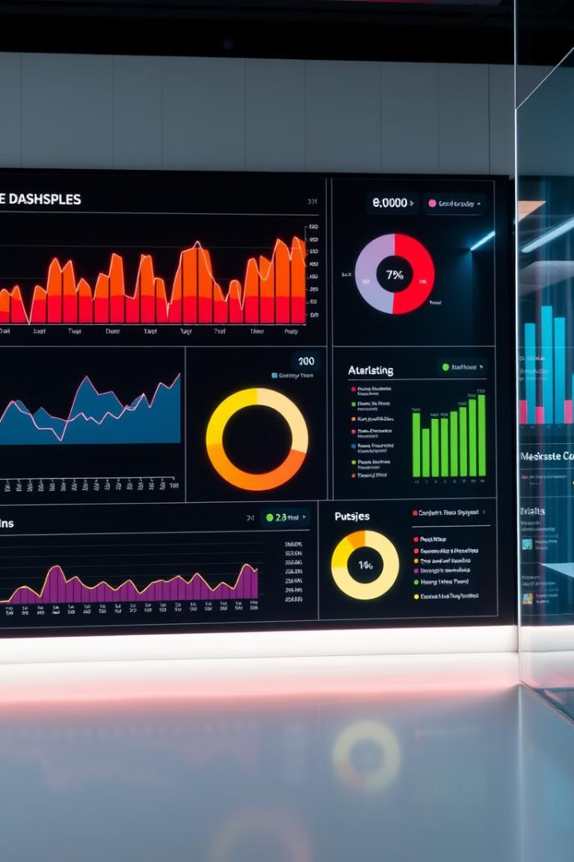

BACHELOR OF ENGINEERING
COMPUTER SCIENCE & ENGINEERING
Blinkit Sales Prediction: Machine Learning and Power BI
Welcome! Today, we'll explore how machine learning and Power BI can help Blinkit predict sales, optimize inventory, and gain real-time insights.
Submitted to:
Mr. Aquib Akhtar
Submitted by:
Ananya Dudeja(2100681540010)
Anshul Tyagi(2100681540011)

Slide 2

Introduction
Overview
Project Goals
Blinkit is a quick-commerce platform that delivers groceries and other essentials within minutes. Predicting sales accurately is vital for optimizing inventory and operations.
This project combines machine learning for sales prediction and Power BI for creating a dynamic and interactive dashboard.

Slide 3

Project Objective
Sales Prediction
Actionable Insights
To accurately predict sales for Blinkit using a machine learning model.
To provide real-time insights through an interactive Power BI dashboard to support informed decision-making.

Slide 4
The Challenge: Unpredictable Demand
Variability
Lack of Real-time Visibility
Demand fluctuates due to seasonal trends, promotions, and location differences, making accurate prediction essential.
Traditional methods often lack real-time data visualization tools, hindering timely and informed decision-making.

Slide 5



Impact: Efficient Operations and Revenue
Lost Opportunities
1
Inefficient inventory management leads to lost revenue opportunities due to overstocking or stockouts.
Inventory Management
2
Accurate predictions enable better inventory planning, reducing waste and improving customer satisfaction.
Increased Sales
3
Optimizing operations and inventory results in improved efficiency and potentially higher sales.

Slide 6
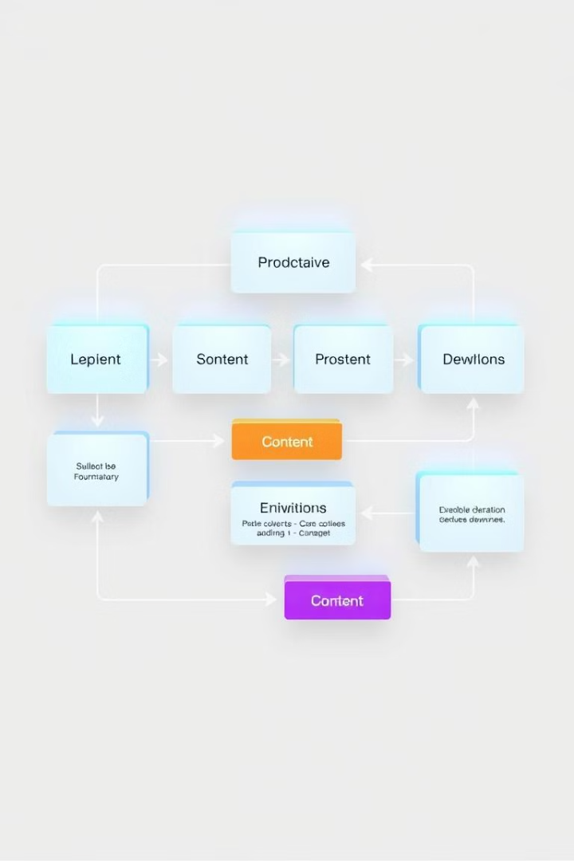
Methodology: From Data to Insights
1
Data Collection and Processing
Gathering sales and store-level data from Blinkit and handling missing values using appropriate techniques.
2
Exploratory Data Analysis (EDA)
Visualizing data distributions, trends, and patterns to understand the factors impacting sales.
3
Model Training
Using XGBoost Regressor to train a predictive model based on the processed data.
4
Dashboard Development
Leveraging Power BI to create a real-time dashboard for visualizing key insights and supporting decision-making.

Slide 7




Findings and Results
ML Results
The XGBoost Regressor achieved a high training R-squared of {{r2\_train}} and a testing R-squared of {{r2\_test}}, indicating strong predictive performance.
Key Insights
EDA revealed that larger outlet sizes generally exhibit higher sales and certain item categories contribute significantly to overall sales.
Power BI Dashboard
The dashboard provides real-time trends of sales across outlets, allowing users to filter by outlet size, location, and year of establishment.

Slide 8
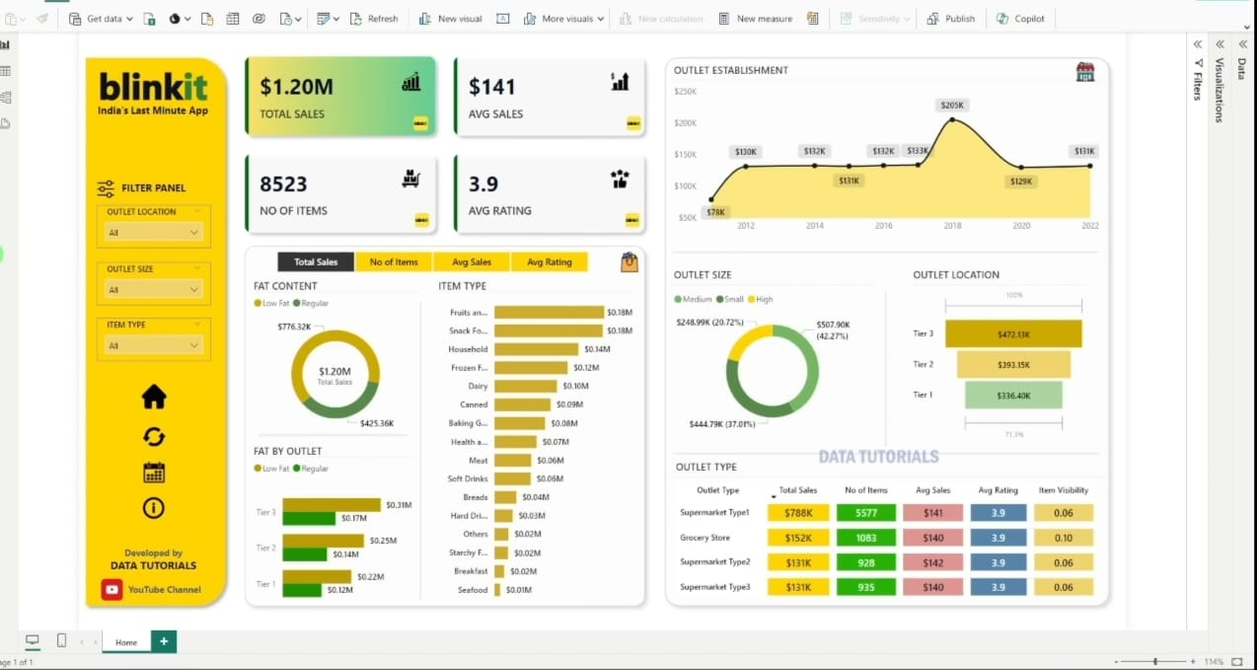
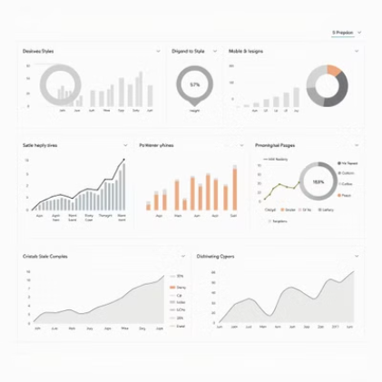
Power BI Dashboard: Visualizing Insights

Slide 9
Conclusion and Future Scope
Key Outcomes
1
A predictive model for Blinkit sales with high accuracy was successfully developed and implemented.
Real-time Insights
2
Power BI dashboards provide real-time data visualizations, empowering data-driven decision-making.
Future Scope
3
Future improvements include incorporating seasonal trends and exploring ensemble techniques for further model optimization.

